Slide 1

Expressive Human and Command Languages
CS 469 / CS 569: Special Topics in Computer Science: Human-Computer Interaction
Dr. Mohammed Ayoub Alaoui Mhamdi
Bishop's University
Sherbrooke, Qc, Canada
malaoui@ubishops.ca

Slide 2
Expressive Human and Command Languages
Topics
Introduction
Speech recognition
Speech production
Human language technology
Traditional command languages Introduction

Slide 3
Introduction
The dream of speaking to computers and having computers speak has long lured researchers and visionaries
Arthur C. Clarke’s 1968 fantasy of the H A L 9000 computer in the book and movie 2001: A Space Odyssey has set the standard for performance of computers in science fiction and for developers of natural language systems
The reality is more complex

Slide 4
Speech Technologies
Store and replay (museum guides)
Dictation (document preparation, web search)
Close captioning, transcription
Transactions over the phone
Personal “assistant” (common tasks on mobile devices)
Hands-free interaction with a device
Adaptive technology for users with disabilities
Translation
Alerts
Speaker identification

Slide 5
Speech Recognition
The place for spoken interaction
Speech recognition applications
Designing spoken interaction
Spoken prompts and commands

Slide 6
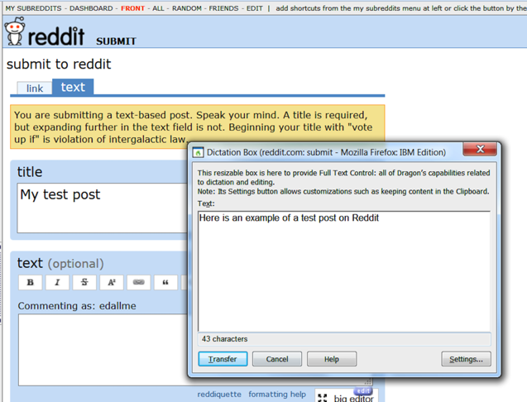
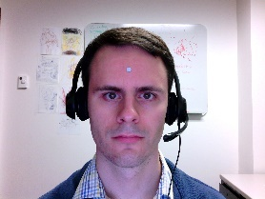
Spoken Interaction
Using Nuance DragonTM speech dictation and a head mouse (as made visible by the little silver dot on his forehead), a computer scientist is able to overcome a temporary hand disability (http://www.nuance.com/dragon/index.htm)
Notes:
Fig. 9.1

Slide 7
Speech recognition and generation: opportunities
When users have physical impairments
When the speaker’s hands are busy
When mobility is required
When the speaker’s eyes are occupied
When harsh or cramped conditions preclude use of a keyboard
When application domain vocabulary and tasks is limited
When the user is unable to read or write (e.g. children)

Slide 8
Speech recognition and generation: obstacles to speech recognition
Interference from noisy environments and poor-quality microphones
Commands need to be learned and remembered
Recognition may be challenged by strong accents or unusual vocabulary
Talking is not always acceptable (e.g. in shared office, during meetings)
Error correction can be time consuming
Increased cognitive load compared to typing or pointing
Math or programming difficult without extreme customization

Slide 9
Speech recognition and generation: obstacles to speech production
Slow pace of speech output when compared to visual displays
Ephemeral nature of speech
Not socially acceptable in public spaces (also privacy issues)
Difficulty in scanning/searching spoken messages

Slide 10
Voice-activated Digital Assistants
A few years ago, you would only see someone talking into their phone if somebody was on the other side
Fast forward a bit and now talking to your phone when you are not on a call is no big deal
Siri for iPhone revolutionized the behavior, and nowadays it is common to see people use their voice to control their phones

Slide 11
Designing spoken interaction (1 of 5)
Initiation
Knowing what to say
Recognition errors
Correcting errors
Mapping to possible actions
Feedback and dialogs

Slide 12
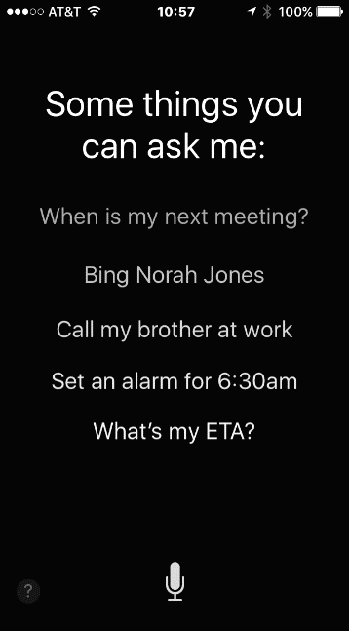

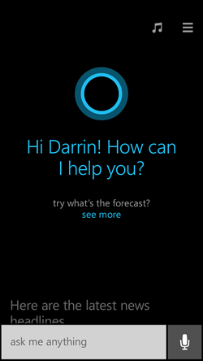
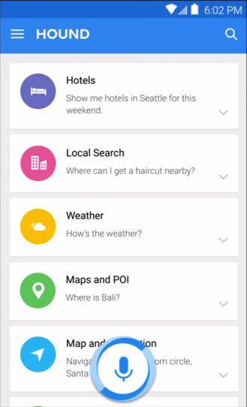
Designing spoken interaction (2 of 5)
Mobile devices assistants (from left to right: Siri, GoogleNow, Cortana and Hound) all have similar microphone buttons, but different ways of presenting suggestions
Notes:
Fig. 9.2

Slide 13
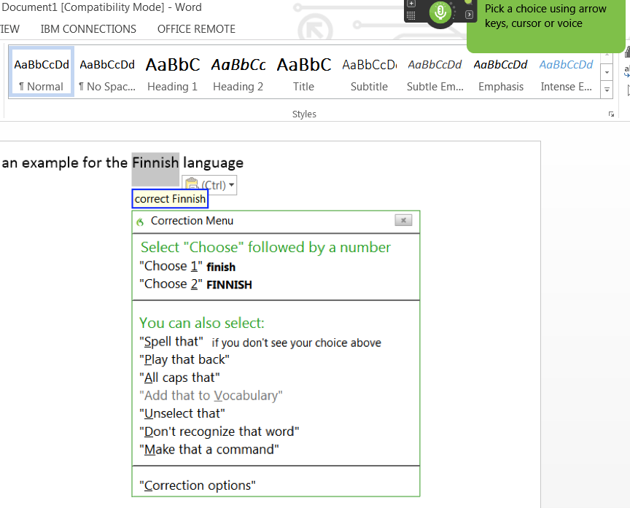
Designing spoken interaction (3 of 5)
Correcting a word during dictation using Nuance DragonTM.
After saying “Correct finnish” the word is selected and possible corrections are displayed in a menu, along with additional commands such as “Spell that”
Users can use the cursor, arrow keys, or voice to specify their choice
Notes:
Fig. 9.3

Slide 14
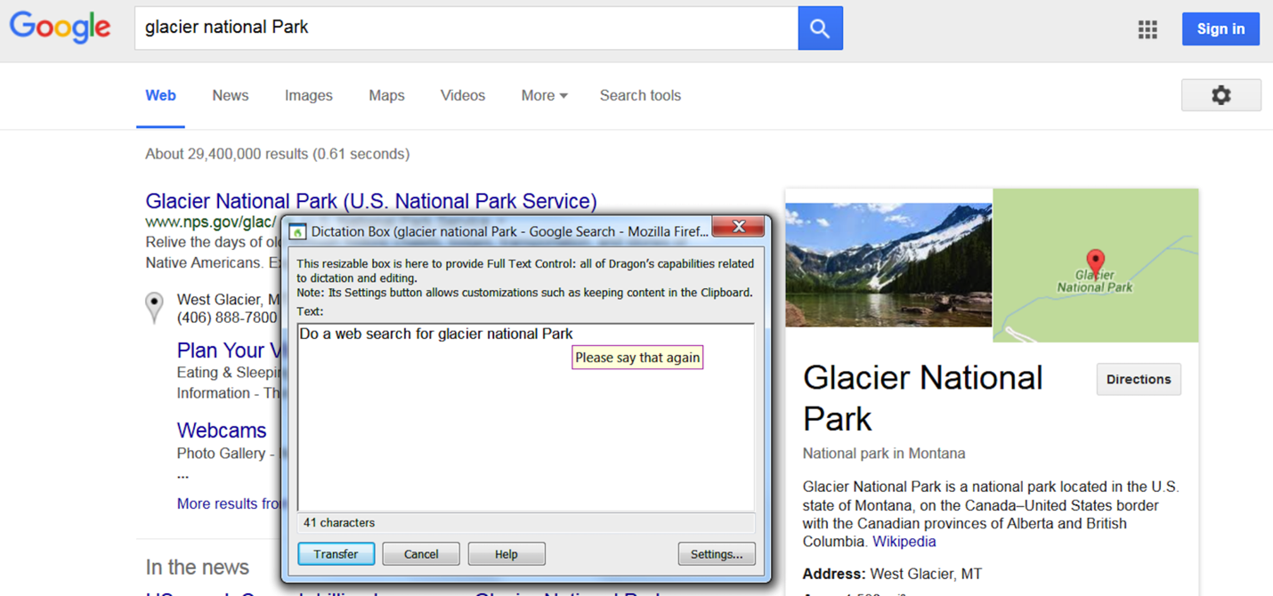
Designing spoken interaction (4 of 5)
It can be difficult to remember what exact command will accomplish the task
In this example when the user said “Search the web for Glacier National Park” a Google search was launched and a search executed with the correct terms, but when the user said “Do a web search for Glacier National Park” the text was indeed accurately recognized but not as a command, so the text was placed in the Nuance DragonTM dictation box
Notes:
Fig. 9.4

Slide 15
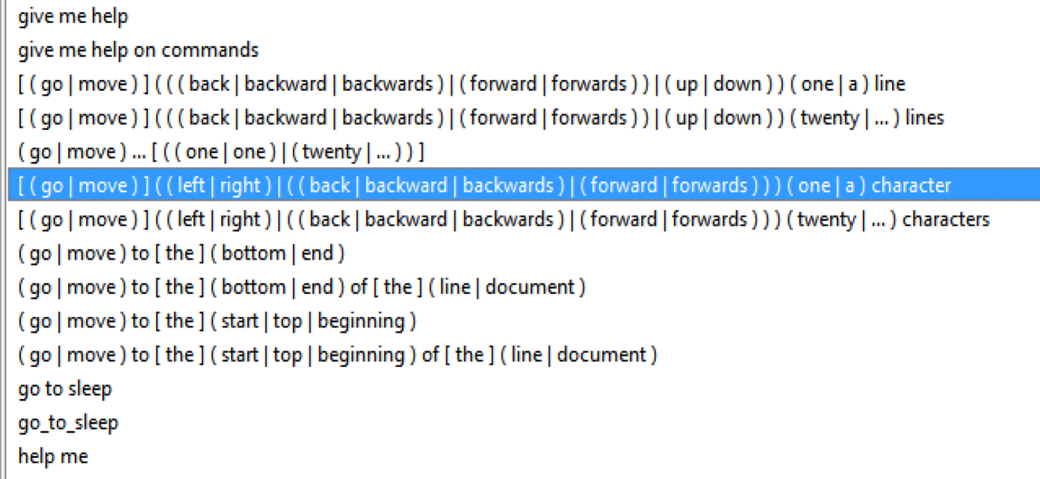
Designing spoken interaction (5 of 5)
A small subset of the rich set of commands used in the Nuance DragonTM speech recognition system
Synonyms are included and used consistently
Notes:
Fig. 9.5

Slide 16
Speech Production (1 of 2)
Speech production is usually successful when the messages are simple and short; and users’ visual channels are overloaded
There are three general methods to produce speech:
Formant synthesis - machine-generated speech using algorithms
Concatenated synthesis - uses tiny, recorded human speech segments
Canned speech - fixed, digitized speech segments

Slide 17
Speech Production (2 of 2)
Examples:
Audio books or audio tours
Instructional systems
Online help systems
Alerts and warnings
Applications for the visually impaired

Slide 18
Human Language Technology (1 of 3)
Machines that understand natural language
Natural language interaction (NLI)
Series of exchanges or “dialog” is difficult to design and build, on even a single topic
Current successes often rely on statistical methods based on the analysis of vast textual or spoken data from millions of users
Example applications and methods include:
Question answering strategies
Extraction and tagging, e.g. gathering data from a database of medical records
Human language text generation
Instructional systems
Language translators, e.g. Google Translate

Slide 19
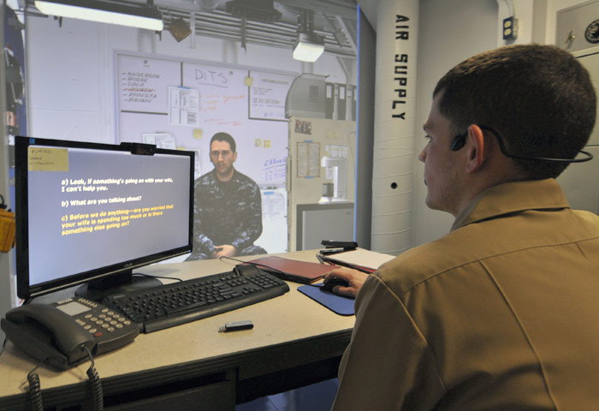
Human Language Technology (2 of 3)
Using the Immersive Naval Officer Training System (I N O T S) new navy officers can practice their counseling skills in a virtual reality environment
Officers listen to an avatar and respond using spoken language, loosely following suggestions from multi-choice prompts presented on the screen and designed to match the learning objectives
The interaction is constrained but assessment is facilitated
(Dyke, 2013; www.netc.navy.mil/nstc/news_page_2012_02_24_2.asp)
Notes:
Fig. 9.6

Slide 20
Human Language Technology (3 of 3)
Google Translate, showing a French sentence translated in English
Notes:
Fig. 9.7

Slide 21
Command Languages (1 of 2)
Command languages are often preferred by expert users who do not want to drag and drop items for repeated steps.
A command language example is the Unix command used to delete blank lines from a file
grep -v ^$ filea > fileb
Casual users favor GUIs but both styles of interface can be made available successfully
Other examples that behave like command languages:
Web addresses (URLs) can be seen as a form of command language
Twitter addresses
Database query languages

Slide 22
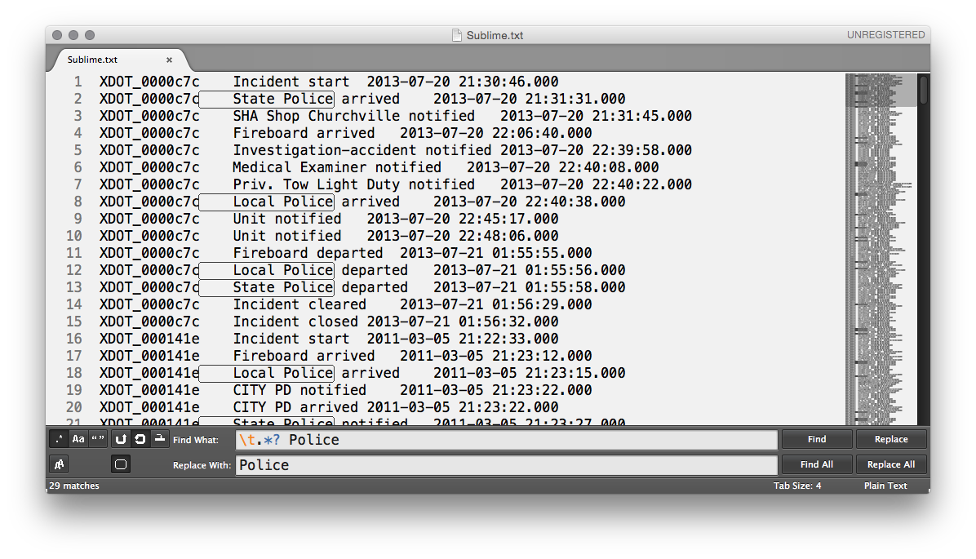
Command Languages (2 of 2)
Using the Sublime text editor a user is doing a search and replace in a data table using regular expressions
Typing “ \t.*? Police” in the search box searches for a tab followed by zero or more character, a space, and then by “Police”
The patterns found in the document are highlighted with a thin black line in the document, showing that both “local police” and “state police” have been found and selected
An overview of the entire document is visible on the right, revealing the presence of many other matches that can now be replaced all at once.
Notes:
Fig. 9.8

